Slide 1
PlayList musicale versione HTML pura
Progetto TIW 2020/2021
Matteo Nunziante

Slide 2
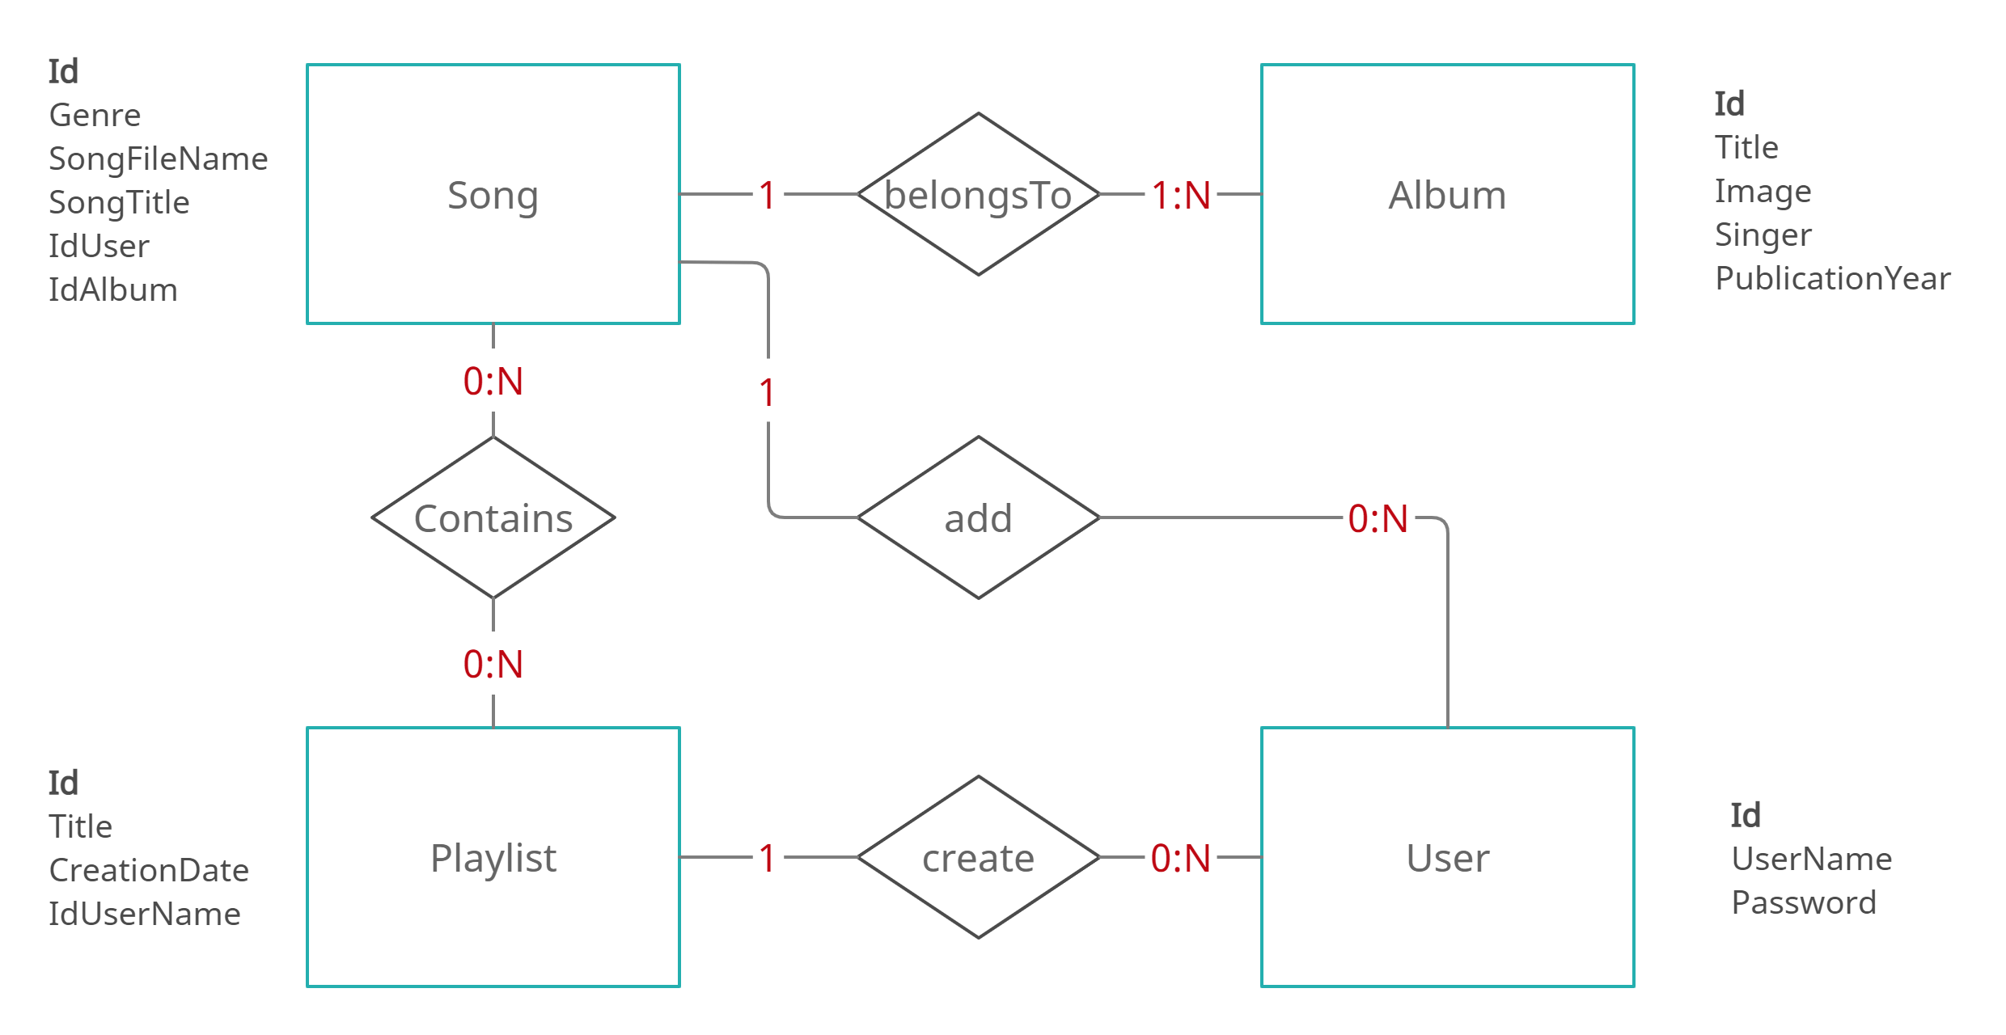
Data Base design

Slide 3
Data Base design
Logical scheme:
USER(Id , UserName , Password)
PLAYLIST(Id , Title , CreationDate , IdUserName)
ALBUM(Id , Title , Image , Singer , PublicationYear)
SONG(Id , Genre , SongFileName , SongTitle , IdUser , IdAlbum)
CONTAINS(IdPlaylist , IdSong)
Foreign keys:
PLAYLIST.IdUserName -> USER.id
SONG.IdUser -> USER.id , SONG.IdAlbum -> ALBUM.Id
CONTAINS.IdPlaylist -> PLAYLIST.Id , CONTAINS.IdSong -> SONG.Id

Slide 4
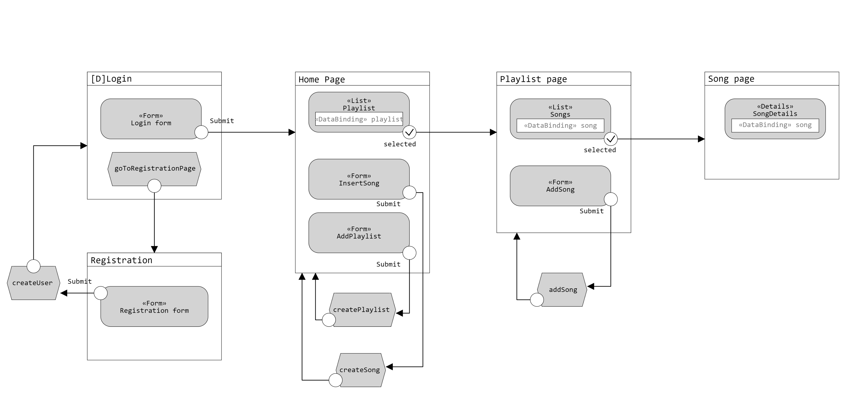
Application Design(IFML)

Slide 5
Components
Model Objects (Beans)
User
Playlist
SongDetails
Data Access Objects (Classes)
UserDAO
findUser(userName)
checkAuthentication(userName , password)
addUser(username , password)
PlaylistDAO
findPlaylist(userId)
findPlaylistbyTitle(title , userId)
createPlaylist(title , creationDate , userId)
findPlaylistById(playlistId , userId)
findPlaylistTitleByID(playlistId)
addSong(playlistID , songId)
SongDAO
-findAlbumId(albumTitle , singer , publicationYear , filename)
createSongAndAlbum(userId , songTitle , genre , albumTitle , singer , publicationYear , imgName , songName)
-createAlbum(albumTitle , singerr , publicationYear , filename)
-createSong(userId , songTitle , genre , albumId , filename)
getSongTitleAndImage(playlistId)
getSongsNotInPlaylist(playlistId , userId)
findSongByUser(songId , userId)
findSongByUser(imageName , userId)
getSongDetails(songId)
findSongByUserId(songName , userId)
Controllers (Servlets)
CheckLogin
Registration
GoToHomePage
CreateSong
CreatePlaylist
GoToPlaylistPage
AddSong
GetImage
GoToSongPage
GetSong
Logout
Views (Templates)
Login.html
Registration.html
HomePage.html
PlaylistPage.html
SongPage.html

Slide 6
Sequence diagrams
Semplificazioni fatte:
Non sono stati riportati i controlli sui parametri in ingresso e la gestione di eventuali errori sugli stessi;
Ogni qual volta viene istanziato un oggetto DAO questo riceve come parametro la connessione al DB.

Slide 7
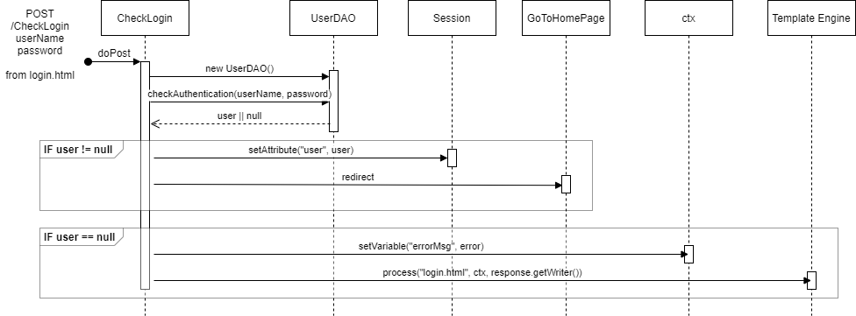
Event: login

Slide 8
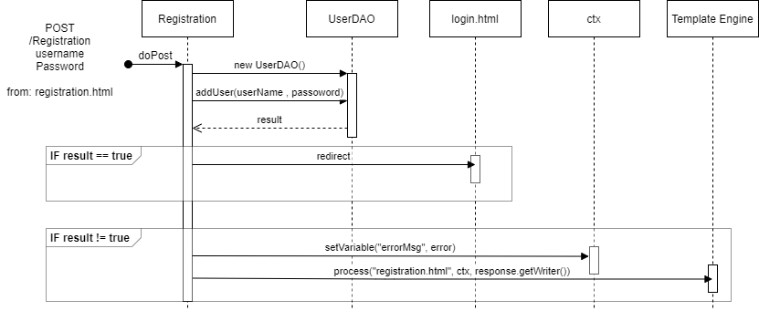
Event: registration

Slide 9
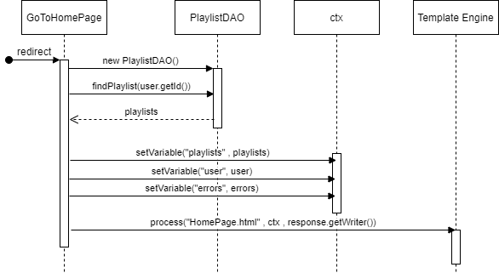
Event: go to home page

Slide 10
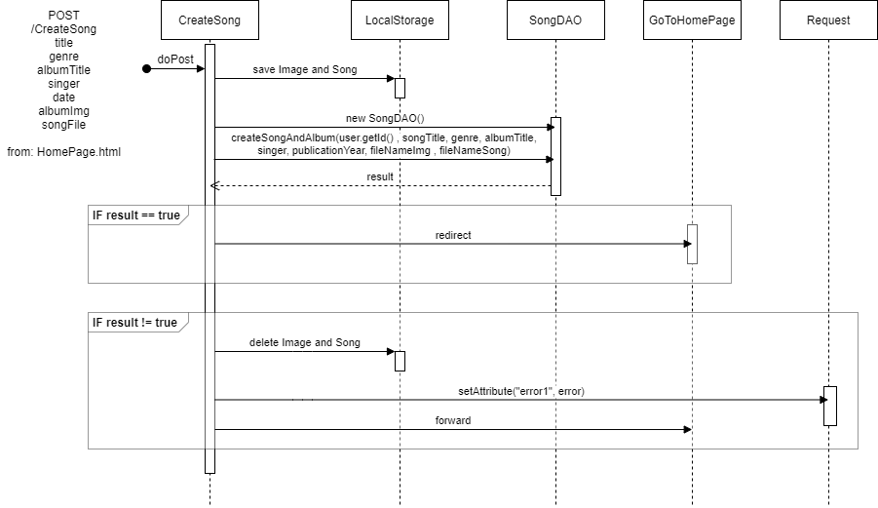
Event: create a new song

Slide 11
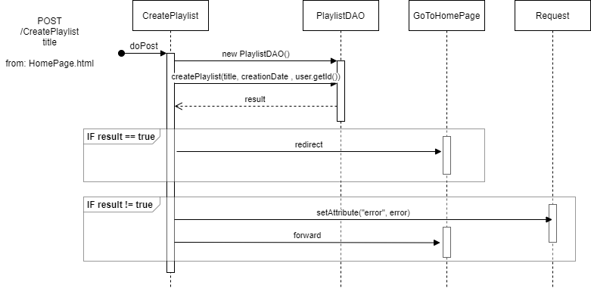
Event: create a new playlist

Slide 12
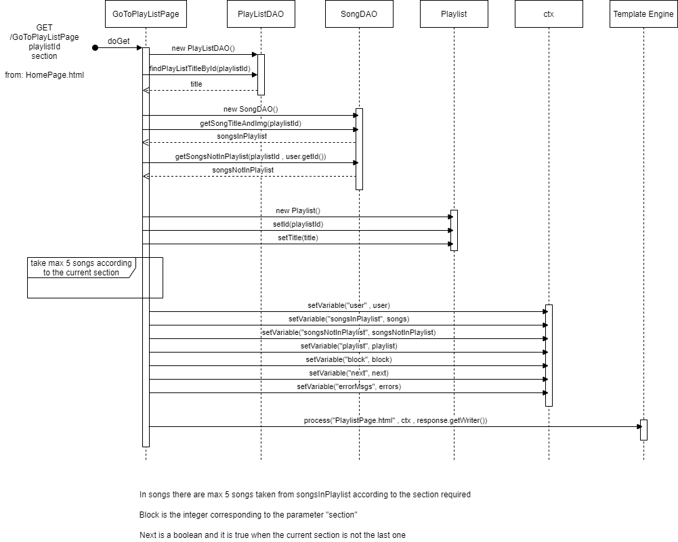
Event: go to playlist page

Slide 13
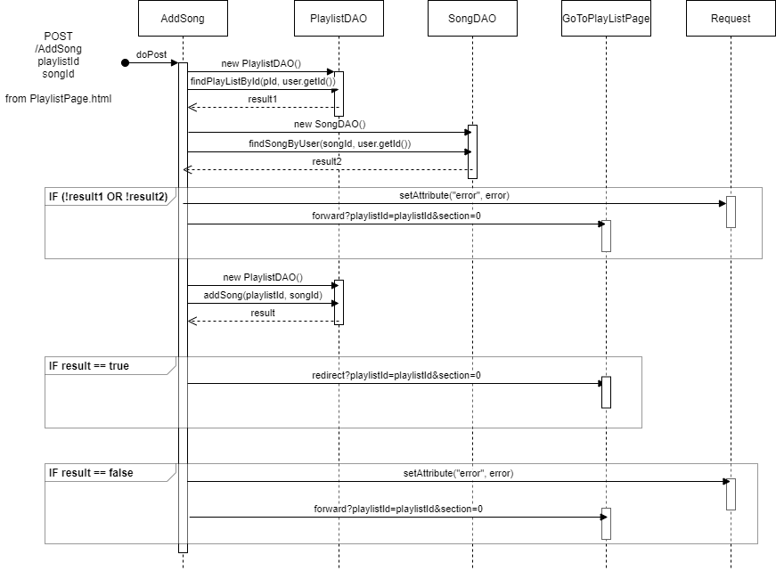
Event: add songs

Slide 14
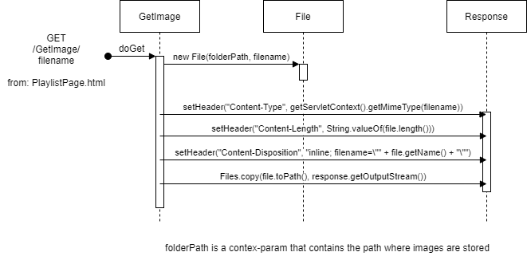
Event: get images

Slide 15
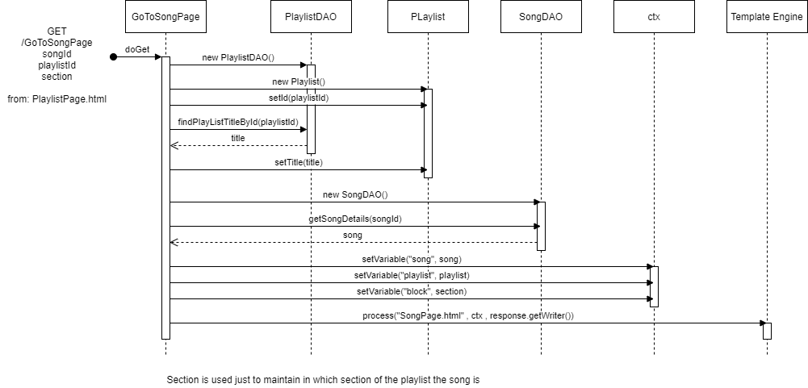
Event: go to song page

Slide 16

Event: get songs

Slide 17
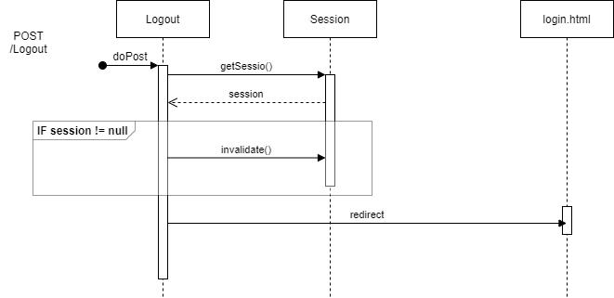
Event: logout

